Slide 1

Hackathon - Transfer Learning with GenAI Tools
Date – 30/04/2025

Slide 2

Group 8: Front Runners
Participants Name | Participants ID
Arpita Uttamrao Thokal | 24005907
Cristina Baron Suarez | 23069038
David Ojomo | 07168946
Edward Leen | 23090780
Jency Francis | 23082639
Sandra Mugao | 23002387
Sherin Johny | 23050521
Tiasa Malitya | 24005709

Slide 3
Objective
Understand and explore the SVHN dataset containing real-world digit images.
Preprocess the dataset to handle challenges like cluttered backgrounds and overlapping digits.
Apply transfer learning using a pre-trained CNN for efficient feature extraction.
Build and train a robust image classification model to predict digits (0–9) accurately.
Evaluate model performance using validation and test accuracy metrics.
Compare and analyze outputs generated by different GenAI tools (ChatGPT, Gemini, DeepSeek, Copilot).
Document the entire process and insights to showcase the impact of GenAI in real-world machine learning workflows.

Slide 4
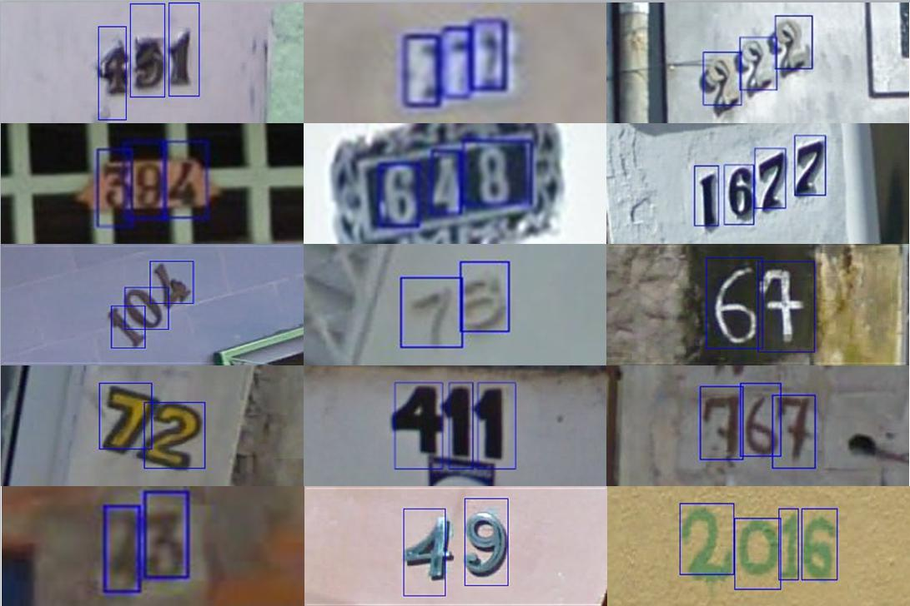
Dataset Descriptions
Dataset: SVHN (Street View House Numbers)
Objective: Recognize digits (0–9) from real-world house number images captured by Google Street View.
Image Format: Colored, cropped images of size 32×32 pixels.
Classes: 10 digit classes (0 through 9)
Dataset Size: 630,000 labeled images
train: 73,257 images
test: 26,032 images
extra: 531,131 images (optional for extended training)
Features: image (32x32 RGB), label (digit), id (text)
Label type: Categorical integer (0–9)

Slide 5
Preprocessing Steps by Each GenAI
ChatGPT | Deepseek | Copilot | Gemini
✅ Normalize to [0,1] ✅ One-hot encoding ✅ 10% val split from train 🔄 Augmentation: • Flip • Rotation • Zoom • Translation | ✅ Normalize ✅ Resize ✅ One-hot encoding 🚫 No val split 🔄 Augmentation: • Flip • 90° Rotation • Crop & Resize • Brightness • Contrast | ✅ Normalize to [0,1] ✅ One-hot encoding 🚫 No val split 🔄 Augmentation: • Rotation • Zoom • Translation • Flip (horizontal) | ✅ Normalize to [0,1] ✅ One-hot encoding ✅ 15% val split 🔄 Augmentation: • Rotation • Zoom • Translation 🚫 No flips (digit-safe)

Slide 6
Gemini Output and Analysis
SVHN : reading house numbers from photos taken on a busy street- MNIST : reading clean digits written on paper
Model : EfficientNet-B0 pre-trained on ImageNet
Results :- Dominant digits monopolized the updates (class imbalance)- Minimal augmentation -> Fragil model- Learning rate too aggressive
How to improve the model: - Gradually un-freeze later EfficientNet blocks- Learning Rate: 0.0001- Strong cropping, blur, and color jitter- Rebalance classes with weighted or focal loss- Train longer

Slide 7
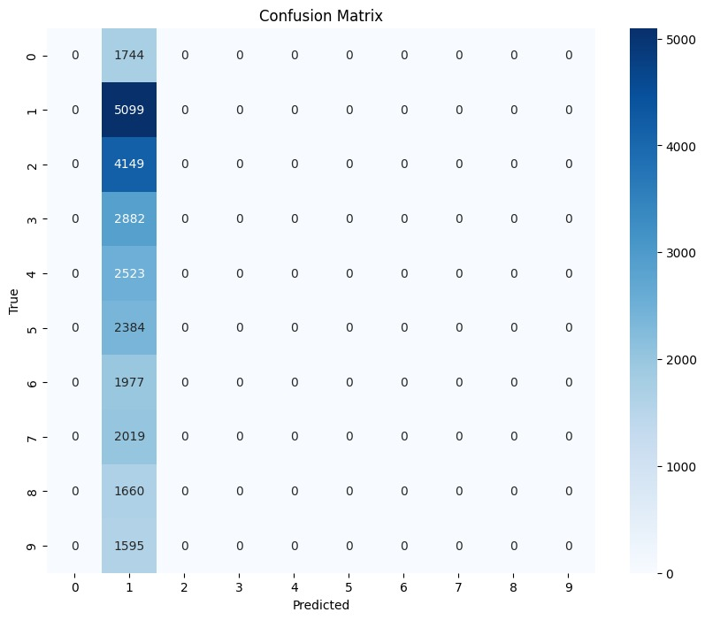
DeepSeek Output and Analysis
The first prompt using EfficientnetB0 had an accuracy of 18.85
It also consisted of 4 errors in the code
The second model used Mobilenet had an accuracy of 18.89
It consisted of no errors
Mobilenet is lightweight and Deepseek used this as it is faster model

Slide 8
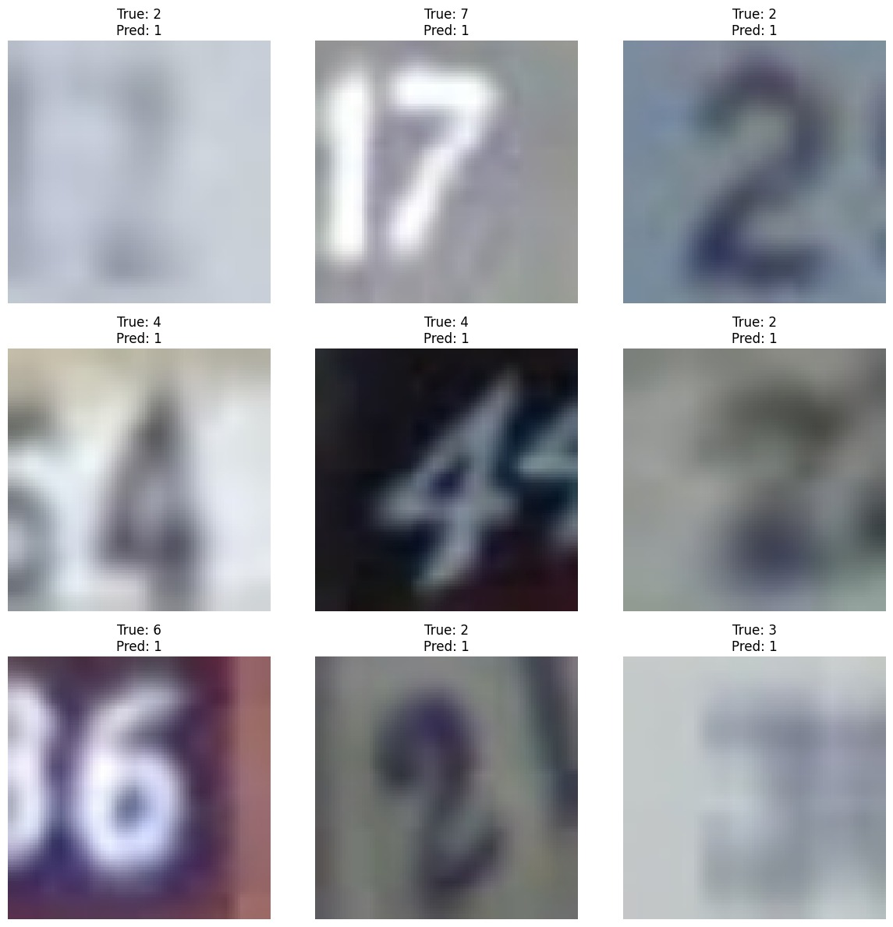
DeepSeek Output and Analysis

Slide 9
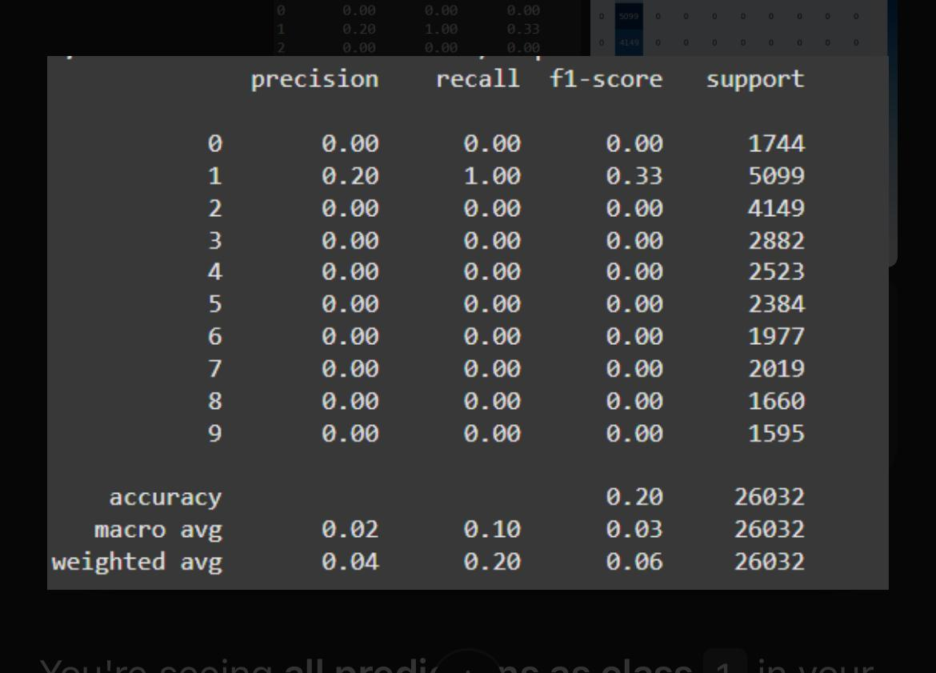
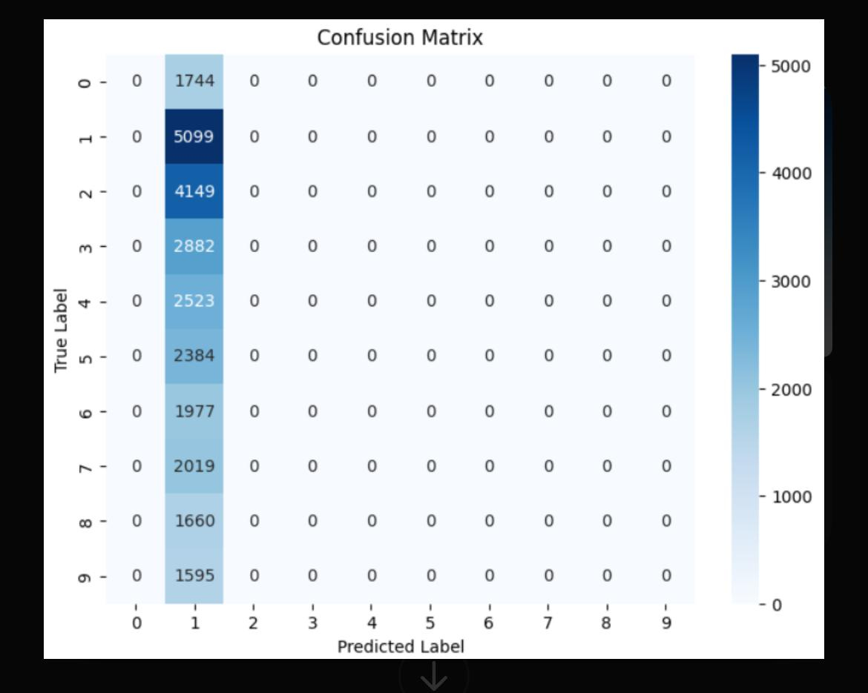
ChatGPT Output and Analysis
Justification for getting all the prediction as 1 in confusion matrix:Training MisconfigurationImproper Output Layerpretrained model

Slide 10
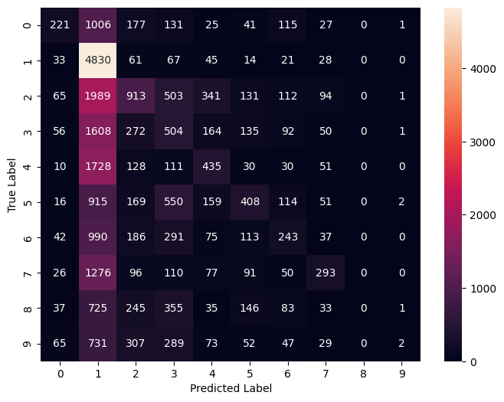
Copilot Output and Analysis
Copilot Brief: Promts: 6
Errors: Multiple i.e not using function defined
Accuracy: Comperatively high (~30%) after 5 epochs after switching to ResNet50
Model evaluation: Copilot provided a confusion matrix, which shows that the model did well at predicting True 1 values

Slide 11
Comparison of the 4 Gen AI
Feature | ChatGPT | Gemini | DeepSeek | Copilot
Model | EfficientNet | EfficientNet | MobileNetV2 | Resnet
Resize | 224x224 | 224x224 | 96x96 | (32, 32, 3)
Label Encoding | One-hot encoded | One-hot encoded | One-hot encoded | One-hot encoded
Loss Function | categorical_crossentropy | categorical_crossentropy | categorical_crossentropy | categorical_crossentropy
Dense Layer Units | 128units | 512units | 128units | 128 units
Dropout | 0.3 | 0.5 | 0.3 | 0.5
Explanations Quality | Detailed, step-by-step | Insightful | Comprehensive | Good
Training History Plotting | Enabled | Yes | Included | No
Fine-tuning | Yes | No | Applied | No
Overall Style | Modular | Modular | Modular | Modular

Slide 12
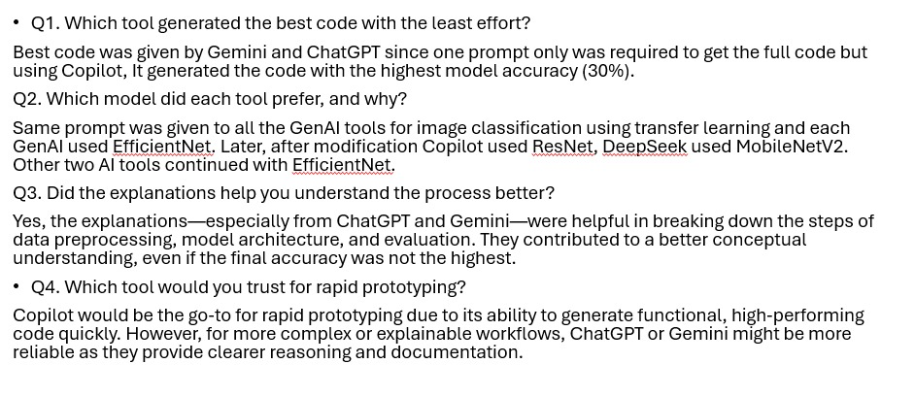
Conclusion

Slide 13
Thank You!

